Slide 1

Maharashtra Institute of Technology Department of Computer Engineering

Slide 2
Quick Sort using OpenMP on Different size of Dataset
High Performance Computing
Members :
Yoganand Kanhed 402077
Kakad Rishikesh 402075
Vaibhav Gole 402062

Slide 3
Problem Statement
Design a program which DEMONSTRATES sorting of data using quick sort algorithm with parallel execution of threads using OpenMP directives in C++ on different size of datasets.

Slide 4
Why OpenMP?
OpenMP is a standardized directive-based multi-language high-level parallelism API that is performant, productive and portable.
OpenMP (Open Multi-Processing) is an application programming interface (API) that supports multi-platform shared memory multiprocessing programming.

Slide 5
Implementation Steps:
Perform an initial data partition and give the two subsets to two available processes.
Each process performs the data partition if there is any available process. Then send a sub part of data to the available process.
Perform the ordinary quick sort on the sub data if no more process is available.
Send the sorted sub data to its sender.
Get the exact sorted data set

Slide 6
Algorithm steps:
Pick an element, called a pivot, from the array.
Reorder the array so that all elements with values less than the pivot come before the pivot, while all elements with values greater than the pivot come after it (equal values can go either way). After this partitioning, the pivot is in its final position. This is called the partition operation.
Recursively apply the above steps to the sub-array of elements with smaller values and separately to the sub-array of elements with greater values.

Slide 7
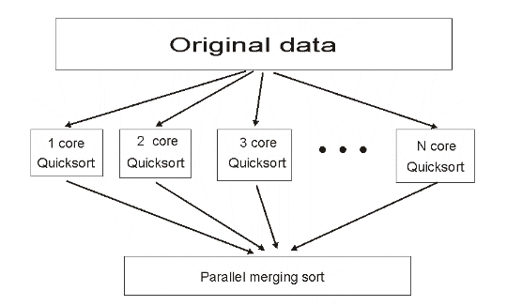
High Level Diagram:

Slide 8
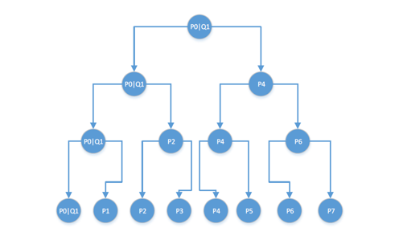
Low Level Diagram

Slide 9
Results:
Size od dataset: | Parallel execution time(second) | Serial execution time(second)
2 | 0.250631 | 0.155379
4 | 0.477811 | 0.588359
8 | 0.92485 | 2.17711

Slide 10
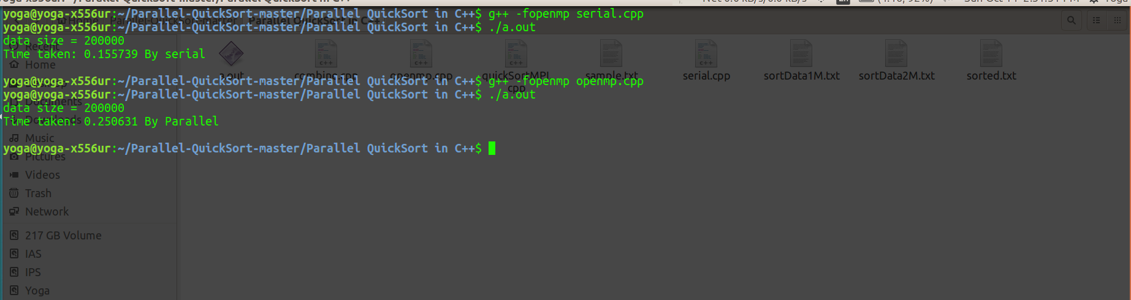
For 2MB dataset:

Slide 11
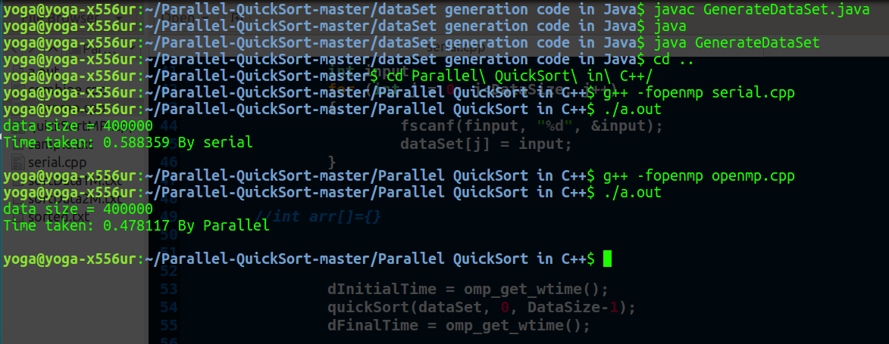
For 4MB dataset:

Slide 12
Conclusion:
The parallel quicksort using OpenMP, we got a chance to have a further understanding of parallel algorithm especially sorting algorithm. We wondering if there is some better strategy of the pivot choice also better load balance. Parallel algorithm is powerful in dealing with big data.

Slide 13
Applications and Future Scope
Optical character Recognition
Library
Search Engine Optimization
Database search
Support for multiple files
Web searching
Parallel parallel searching
Integration with word processors and editors

Slide 14
References
https://www.openmp.org

